Slide 1
AZ-900T0x Learning Path: Explore Microsoft Azure Cloud concepts
Notes:
Adjust the title page for AZ-900T00 or AZ-900T01.

Slide 2
Learning objectives

Slide 3

Learning Objectives
You will learn the following concepts:
Why Cloud
Definition of cloud computing
Benefits of the cloud
Cloud Models
Public, Private, and Hybrid cloud
Choosing the best for you
Cloud Services
IaaS, PaaS, and SaaS
Sharing responsibility
Notes:
This slide is important. We are telling the learners… This is what I am going to tell you.
We then tell them / show them.
At the end we review what we told them.
Then we give them references for further learning.
Then we say Thanks you where we will then put our closing deck for customer feedback…

Slide 4


Module: Discuss why cloud services?

Slide 5
Discuss Why Cloud Services Introduction
Learning Objectives:
Explore common cloud computing services
Explore the benefits of cloud computing

Slide 6




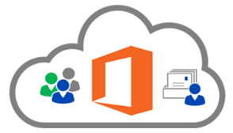
Define cloud computing
Compute
Storage
Networking
Analytics
Cloud providers include Microsoft, Amazon, and Google
Notes:
Cloud computing - https://azure.microsoft.com/en-us/overview/what-is-cloud-computing/
Compute power - such as Linux servers or web applications.
Storage - such as files and databases.
Networking - such as secure connections between the cloud provider and your company.
Analytics - such as visualizing telemetry and performance data.

Slide 7
Try This Exercise
Open a browser.
Enter the URL www.portal.azure.com
Take a few minutes and look at the site.
Can you find:
where to create a resource like a Virtual Machine?
how to launch your Dashboard to see what resources you have?
where Microsoft Learn training site is linked right into Azure to help you learn?
Close your browser.

Slide 8
Explore key cloud concepts
High availability
Fault tolerance
Scalability
Elasticity
Global reach
Customer latency capabilities
Agility
Predictive cost considerations
Disaster recovery
Security
Notes:
There is a term reference guide available at https://azure.microsoft.com/en-us/overview/cloud-computing-dictionary/

Slide 9
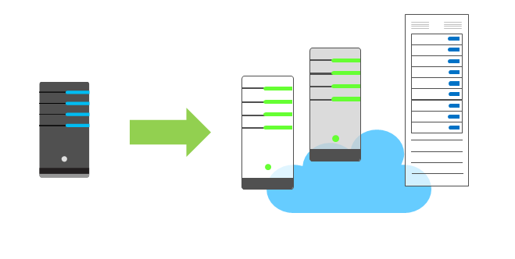
Discuss economies of scale
Economies of scale – Cloud providers can reduce costs and gain efficiency when operating at a large scale.
Notes:
Cloud providers are very large businesses, and thus can leverage the benefits of economies of scale and then pass those benefits on to their customers.

Slide 10
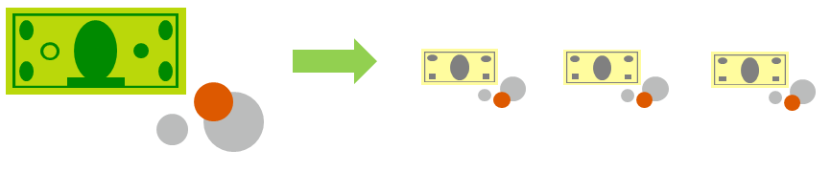
Compare CapEx vs. OpEx
Capital Expenditure (CapEx)
High upfront cost, value of investment reduces over time.
Operational Expenditure (OpEx)
Spend on services or products as needed.
No upfront cost, pay-as-you use.

Slide 11
Define consumption-based model
Consumption-based model = Pay only for the resources you use
Notes:
This consumption-based model brings with it many benefits, including:
No upfront costs.
No need to purchase and manage costly infrastructure that they may or may not use to its fullest.
The ability to pay for additional resources when they are needed.
The ability to stop paying for resources that are no longer needed.

Slide 12

Knowledge Check Populate with instructions to use the polling tool of your choice
Which one?
A). Azure Portal
B). PowerShell
C). Local Tool
Module: Discuss why cloud services
Use your Smartphones or Mobile Devices
Go to (insert polling app link of your choice) Enter Code: 123-45-678
Please participate in the quiz for this section
Notes:
WWL recommends using polling to be completed for every 7 – 10 slides and preferably at the end of each section. This helps break classes up and adds more interactivity especially for remote classes.
In order to promote interactivity, WWL suggests the use of Mentimeter, Kahoot or a similar polling technology. Please feel free to adjust this slide as needed and populate with the instructions based on the polling tool of your choice.

Slide 13
Summary - Discuss why cloud services
In this module, you've learned about cloud computing, what it is and what its key characteristics are. Here are some of the things you covered:
Types of cloud models and when to use which.
Key terms and concepts such as high availability, agility, elasticity, fault tolerance, and CapEx vs. OpEx.
Learn more:
Cloud Computing Terms
What is Azure?
Azure compliance offerings
Azure Architecture Center
Overview of Azure compute options

Slide 14
Module: Distinguish types of cloud models

Slide 15
Distinguish Types of Cloud Models Introduction
Learning Objectives
Explore Public, Private, and Hybrid cloud models
Decide which cloud deployment model is best for you

Slide 16
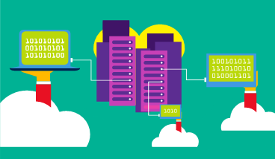
Define public cloud
Owned by cloud services or hosting provider.
Provides resources and services to multiple organizations and users.
Accessed via secure network connection (typically over the internet).
Notes:
What are public, private, and hybrid clouds? - https://azure.microsoft.com/en-us/overview/what-are-private-public-hybrid-clouds/

Slide 17
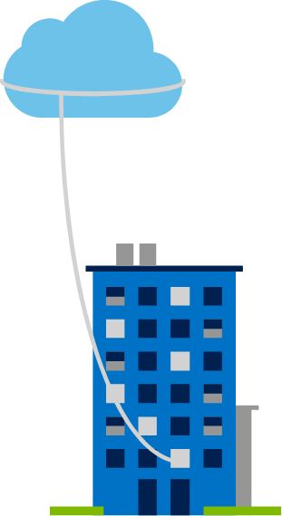
Define private cloud
Organizations create a cloud environment in their datacenter.
Organizations responsible for operating the services they provide.
Notes:
Owned and operated by the organization.
Organizations create a cloud environment in their datacenter.
Self-service access to compute resources provided to users within the organization.
Organizations responsible for operating the services they provide.

Slide 18
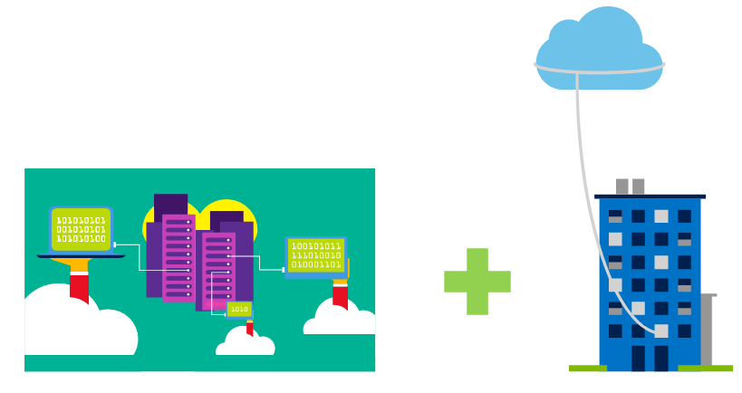
Define hybrid cloud
Combines Public and Private clouds to allow applications to run in the most appropriate location.
Notes:
Hybrid cloud models have the following characteristics:
Resource location. Specific resources run or are used in a public cloud, and others run or are used in a private cloud.
Cost and efficiency. Hybrid cloud models allow an organization to leverage some of the benefits of cost, efficiency, and scale that are available with a public cloud model.
Control. Organizations retain management control in private clouds.
Skills. Technical skills are still required to maintain the private cloud and ensure both cloud models can operate together.

Slide 19
Compare cloud models
Public cloud:
No capital expenditures to scale up.
Applications can be quickly provisioned and deprovisioned.
Organizations pay only for what they use.
Private cloud:
Organizations have complete control over resources.
Organizations have complete control over security.
Hybrid cloud:
Most flexibility.
Organizations determine where to run their applications.
Organizations control security, compliance, or legal requirements.

Slide 20

Knowledge Check Populate with instructions to use the polling tool of your choice
Which one?
A). Azure Portal
B). PowerShell
C). Local Tool
Module: Distinguish types of cloud models
Use your Smartphones or Mobile Devices
Go to (insert polling app link of your choice)
Enter Code: 123-45-678
Please participate in the quiz for this section
Notes:
WWL recommends using polling to be completed for every 7 – 10 slides and preferably at the end of each section. This helps break classes up and adds more interactivity especially for remote classes.
In order to promote interactivity, WWL suggests the use of Mentimeter, Kahoot or a similar polling technology. Please feel free to adjust this slide as needed and populate with the instructions based on the polling tool of your choice.

Slide 21
Summary – Distinguish Types of Cloud Models
In this module, you've learned about different types of cloud models and the pro’s and con’s of each type of implementation. You saw content around:
Explore Public, Private, and Hybrid cloud models
Decide which cloud deployment model is best for you

Slide 22
Module: Explore types of cloud services

Slide 23
Explore Types of Cloud Services Introduction
Learning Objectives:
Discuss the Shared Responsibility Model
Review IaaS, PaaS, and SaaS cloud models
Decide which cloud services is best for you

Slide 24
Discuss shared responsibility model
On-Premises
( Private Cloud )
Infrastructure
( as a Service )
Platform
( as a Service )
Software
( as a Service )
Data & Access
Data & Access
Data & Access
Data & Access
Applications
Applications
Applications
Applications
You Manage
Runtime
Runtime
Runtime
Runtime
Cloud Provider Manages
Operating System
Operating System
Operating System
Operating System
Virtual Machine
Virtual Machine
Virtual Machine
Virtual Machine
Compute
Compute
Compute
Compute
Networking
Networking
Networking
Networking
Storage
Storage
Storage
Storage
Notes:
IaaS, PaaS, and SaaS have dedicated topics, coming up.

Slide 25
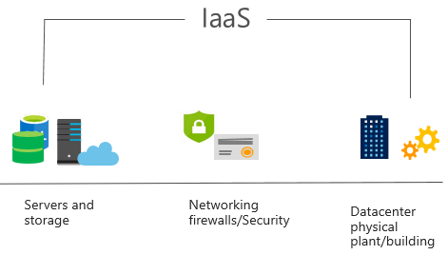
Define Infrastructure as a Service (IaaS)
Build pay-as-you-go IT infrastructure by renting servers, virtual machines, storage, networks, and operating systems from a cloud provider.
Notes:
For more information on IaaS, visit https://azure.microsoft.com/en-us/overview/what-is-iaas/
Most basic cloud computing services category.
Build pay-as-you-go IT infrastructure by renting servers, virtual machines, storage, networks, and operating systems from a cloud provider.
Instant computing infrastructure, provisioned and managed over the internet.

Slide 26
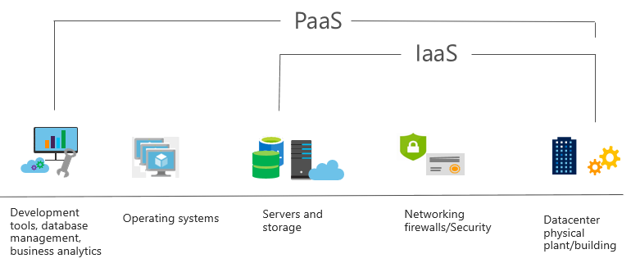
Define Platform as a Service (PaaS)
Provides environment for building, testing, and deploying software applications; without focusing on managing underlying infrastructure.
Notes:
For more information on PaaS, see https://azure.microsoft.com/en-us/overview/what-is-paas/
Provides environment for building, testing, and deploying software applications.
Helps create applications quickly, without focusing on managing underlying infrastructure.

Slide 27
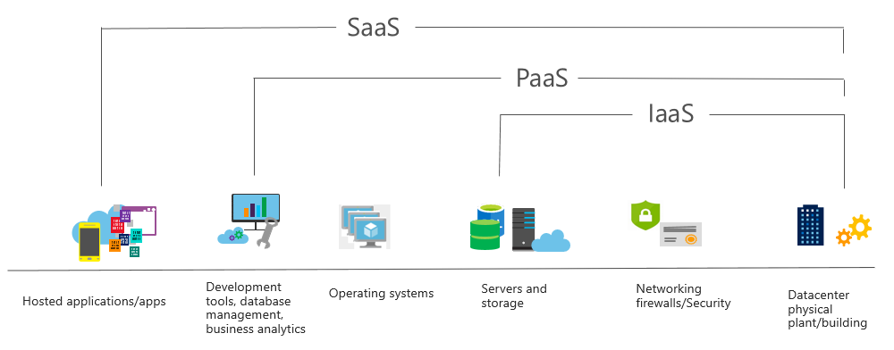
Define Software as a Service (SaaS)
Users connect to and use cloud-based apps over the internet: for example, Microsoft Office 365, email, and calendars.
Notes:
Common usage scenarios:
Examples of Microsoft SaaS services include Microsoft Office 365, Skype, and Microsoft Dynamics CRM Online.
For more information on SaaS, see https://azure.microsoft.com/en-us/overview/what-is-saas/

Slide 28
Compare cloud services
IaaS
PaaS
SaaS
The most flexible cloud service.
You configure and manage the hardware for your application.
Focus on application development.
Platform management is handled by the cloud provider.
Pay-as-you-go pricing model.
Users pay for the software they use on a subscription model.
Notes:
The slide contains only some of the cloud service comparison discussion points.

Slide 29
Knowledge Check Populate with instructions to use the polling tool of your choice
Which one?
A). Azure Portal
B). PowerShell
C). Local Tool
Module: Discuss why cloud services
Use your Smartphones or Mobile Devices
Go to (insert polling app link of your choice) Enter Code: 123-45-678
Please participate in the quiz for this section
Notes:
WWL recommends using polling to be completed for every 7 – 10 slides and preferably at the end of each section. This helps break classes up and adds more interactivity especially for remote classes.
In order to promote interactivity, WWL suggests the use of Mentimeter, Kahoot or a similar polling technology. Please feel free to adjust this slide as needed and populate with the instructions based on the polling tool of your choice.

Slide 30
Summary – Explore Types of Cloud Services
In this module, you've learned about how you can build your cloud solutions in different ways, and that you share responsibility with your cloud provider on who maintains and secures your solutions:
Discuss the Shared Responsibility Model
Review IaaS, PaaS, and SaaS cloud models
Decide which cloud services is best for you

Slide 31
Learning Path review
Notes:
As you have time go through the Module Review questions in the student materials.

